Slide 1
Motor Parameters
DC-link voltage (400 V)
Modulation (SPWM)
Phase Current (10 A)
Field Voltage/Current (15 V-15A)

Slide 2
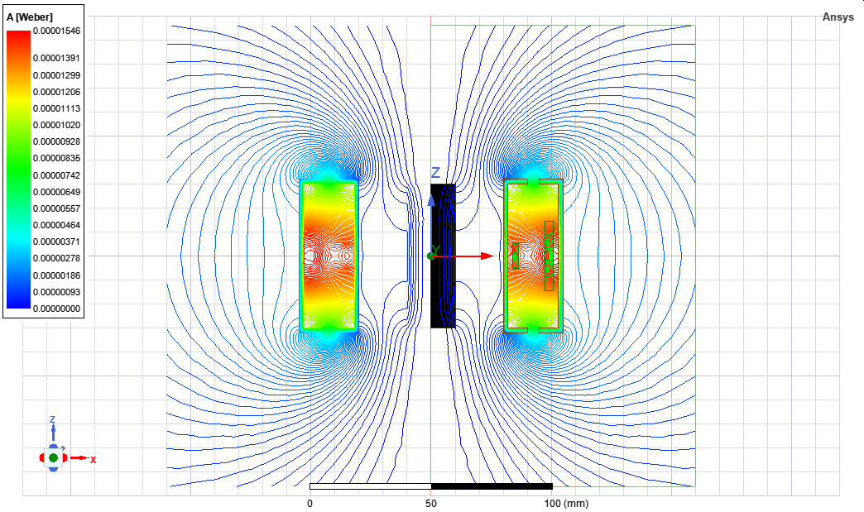


Slide 3



Slide 4



Slide 5
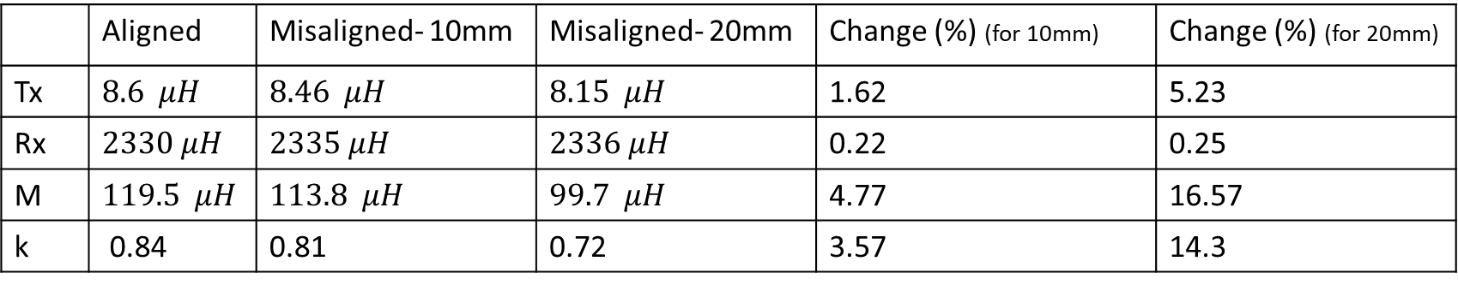
 | Aligned | Misaligned- 10mm | Misaligned- 20mm | Change (%) (for 10mm) | Change (%) (for 20mm)
Tx | $$8.6 μH$$ | $$8.46 μH$$ | $$8.15 μH$$ | 1.62 | 5.23
Rx | $$2330 μH$$ | $$2335 μH$$ | $$2336 μH$$ | 0.22 | 0.25
M | $$119.5 μH$$ | $$113.8 μH$$ | $$99.7 μH$$ | 4.77 | 16.57
k | 0.84 | 0.81 | 0.72 | 3.57 | 14.3

Slide 6
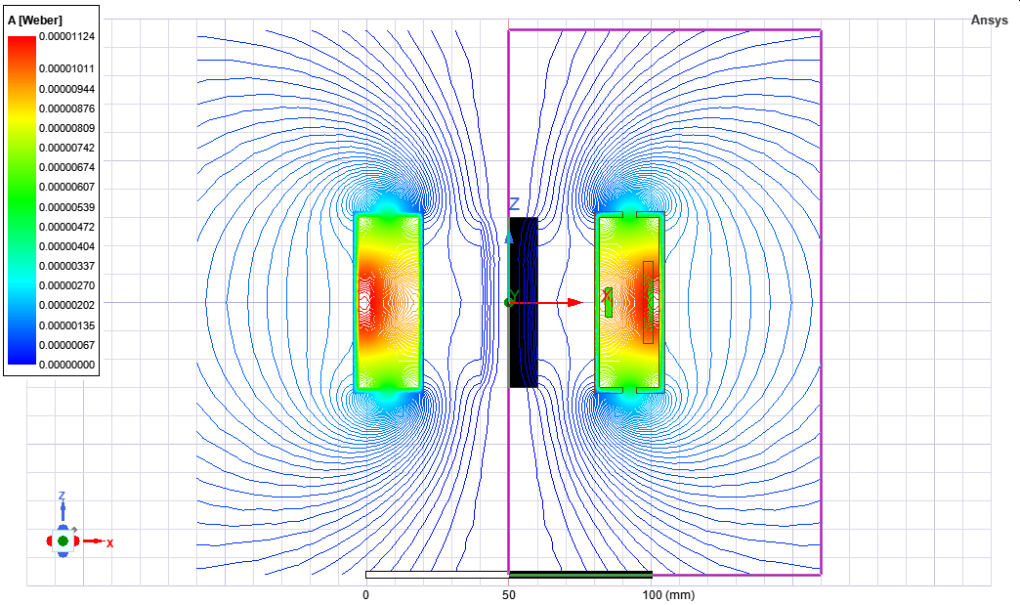

Slide 7
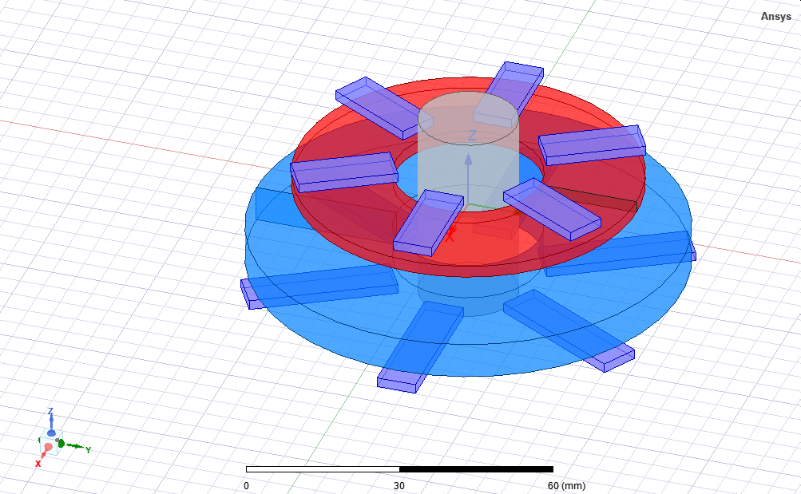

Slide 8
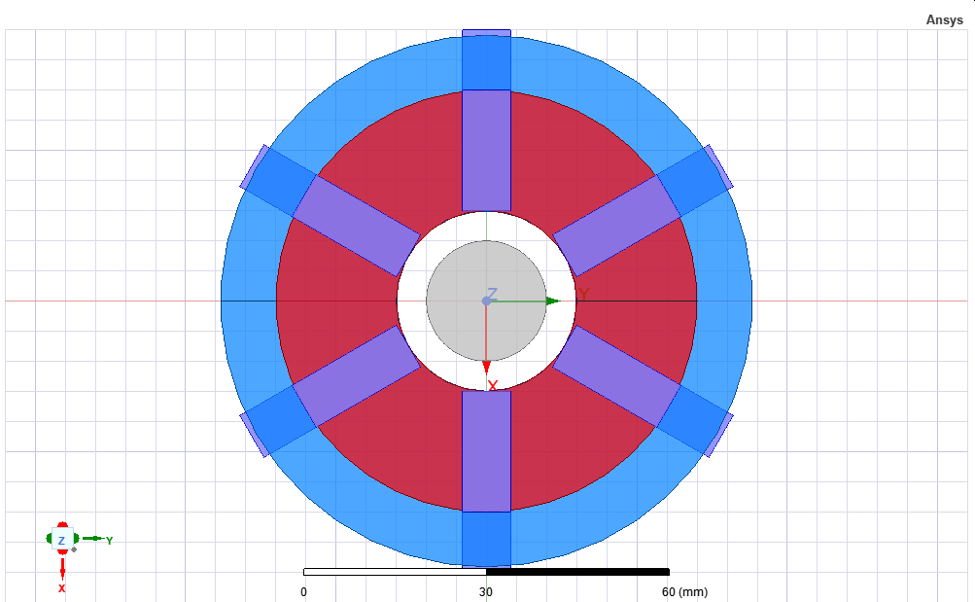
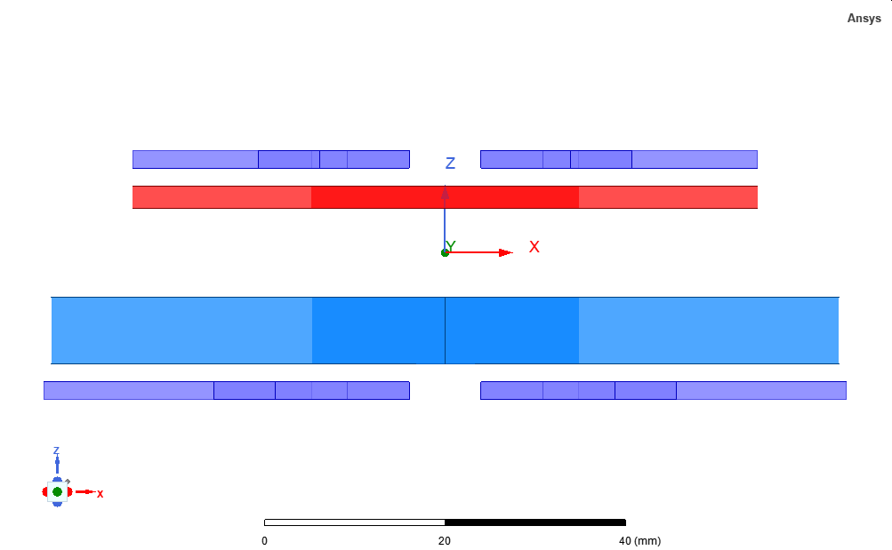

Slide 9
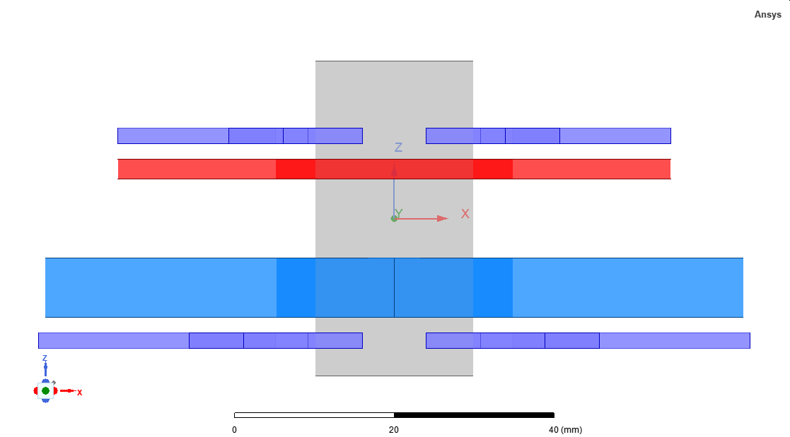
Name Value Unit "Evaluated Value" Type shaft_radius 10 mm 10mm Design shaft_height 40 mm 40mm Design r_inner_Rx 15 mm 15mm Design w_Rx_copper 2.5 mm 2.5mm Design layer_Rx 1 1 Design
airgap 10 mm 10mm Design
Nrx 8 8 Design f2Rx 2 mm 2mm Design w_Rx_fer 8 mm 8mm Design h_Rx_fer 2 mm 2mm Design L_Rx_fer 20 mm 20mm Design r_inner_Tx 15 mm 15mm Design w_Tx_copper 1.25 mm 1.25mm Design Ntx 140 140 Design layer_Tx 6 6 Design w_Tx_fer 8 mm 8mm Design f2Tx 2 mm 2mm Design h_Tx_fer 2 mm 2mm Design L_Tx_fer 30 mm 30mm Design rotation 0 deg 0deg Design Irx 15*Nrx 120 Design
20mm
70mm

Slide 10
Shaft 32mm

